Slide 1
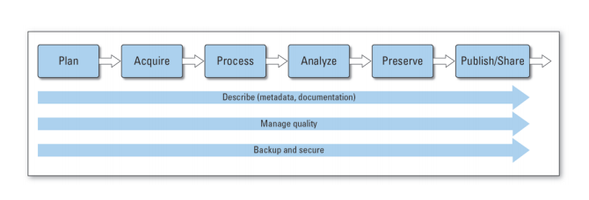
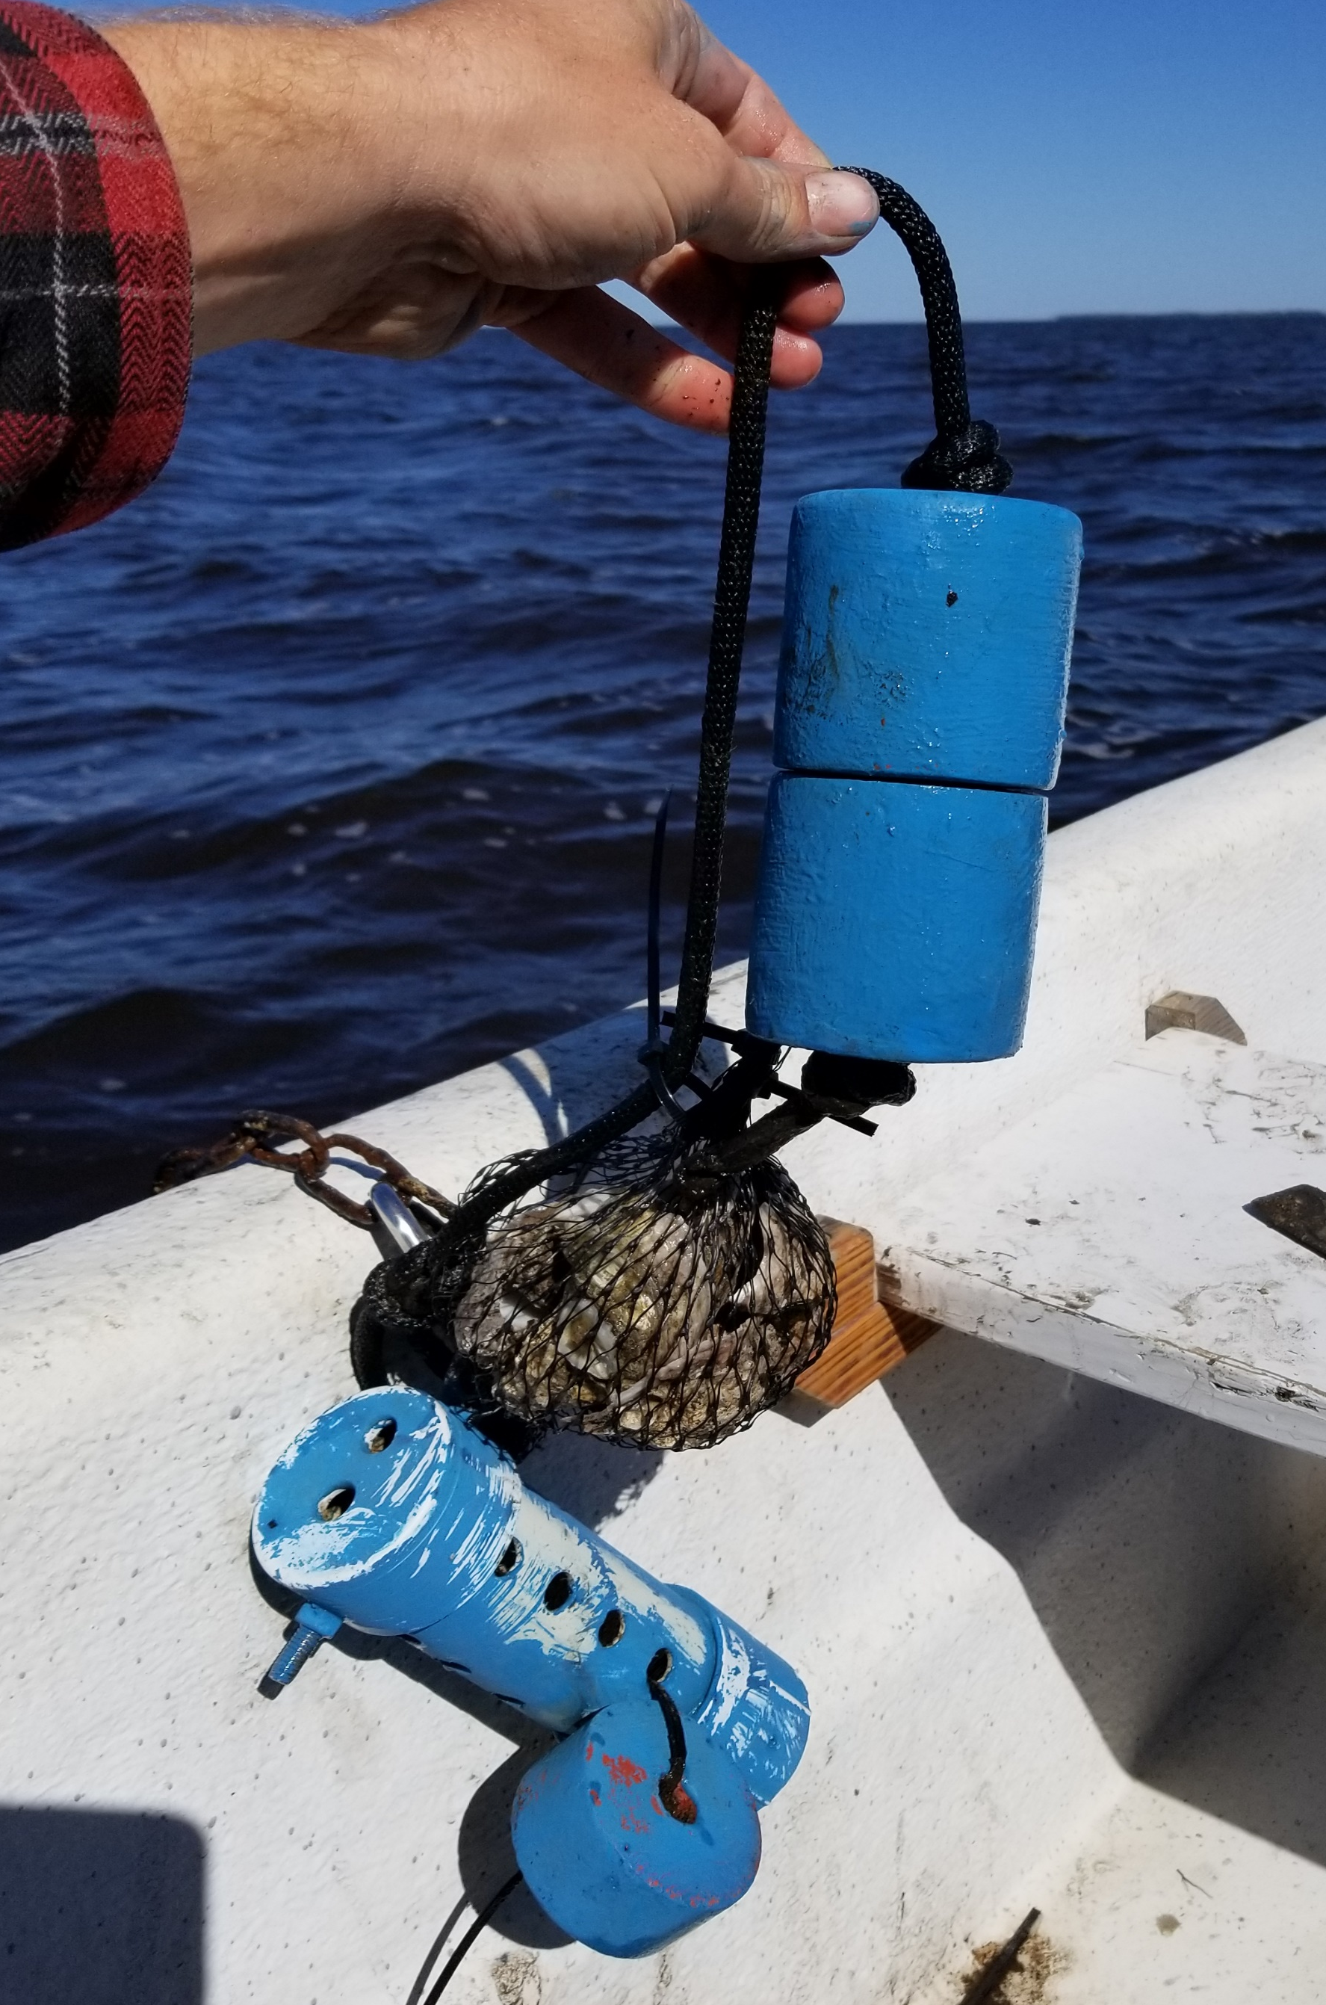
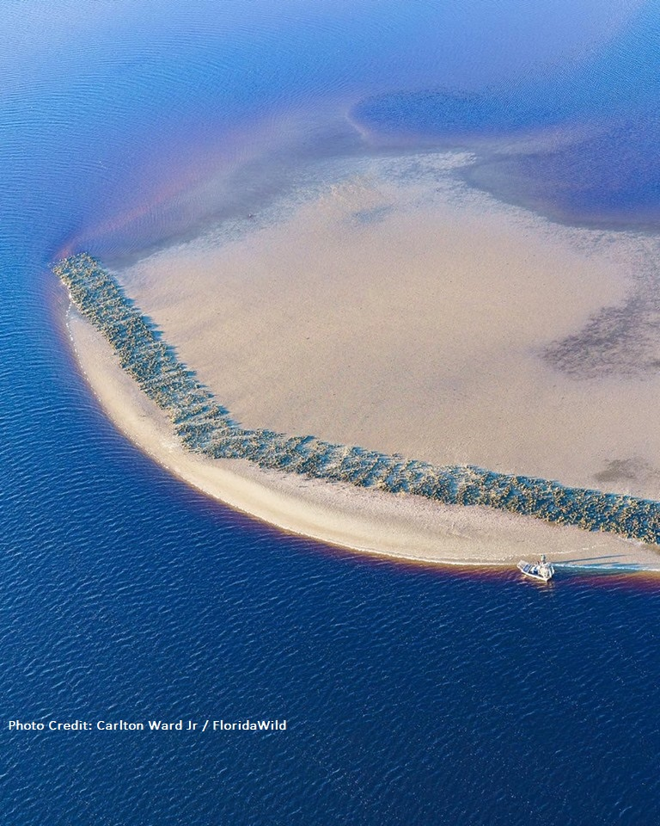
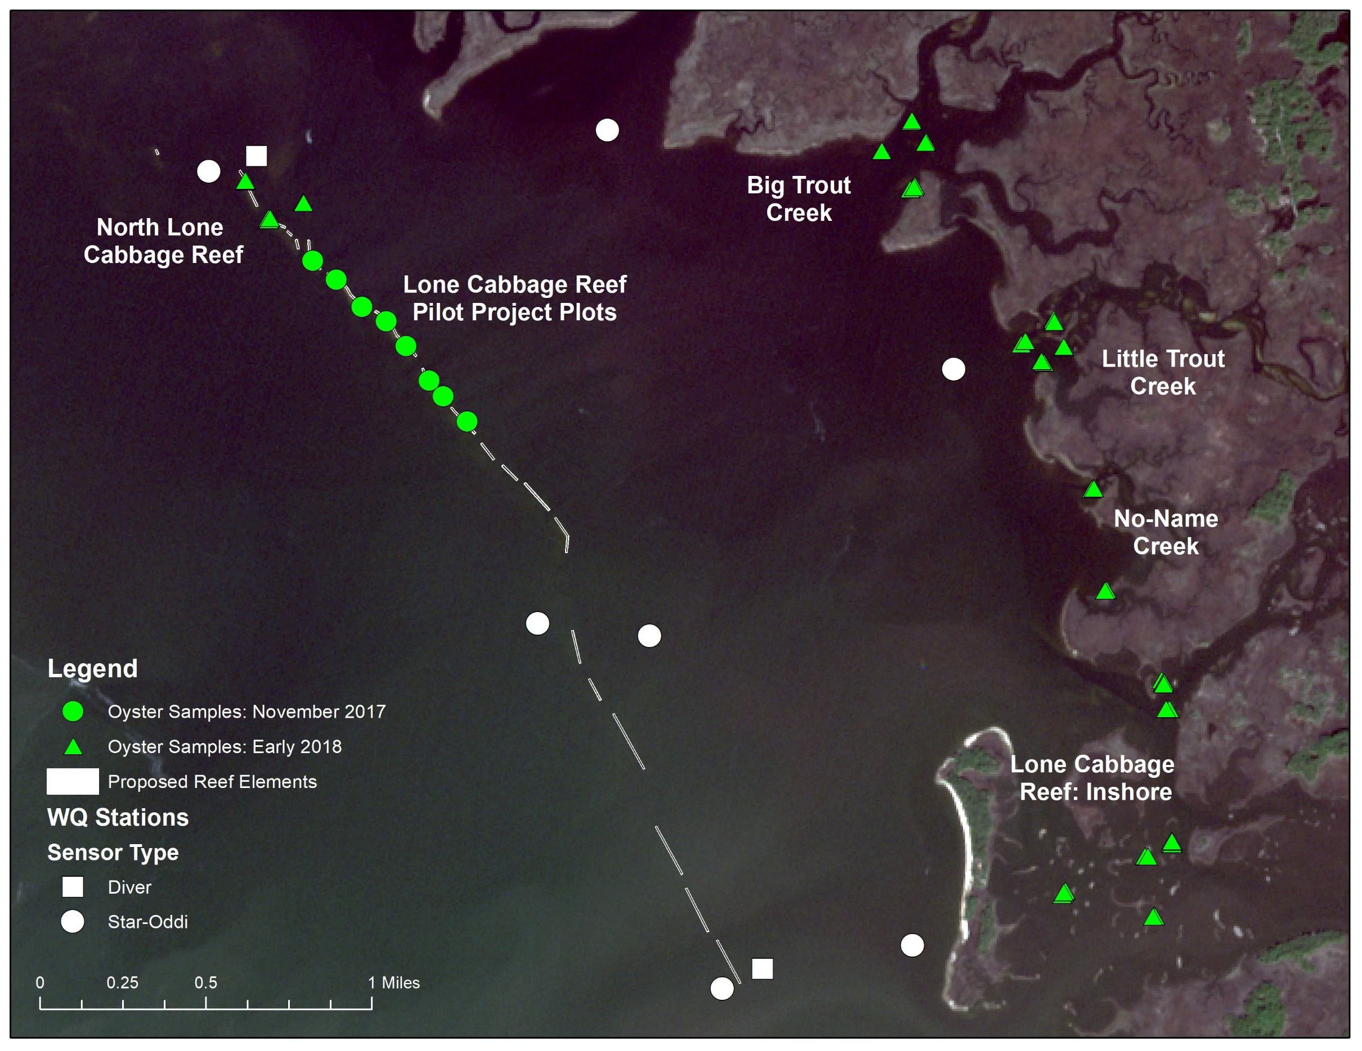
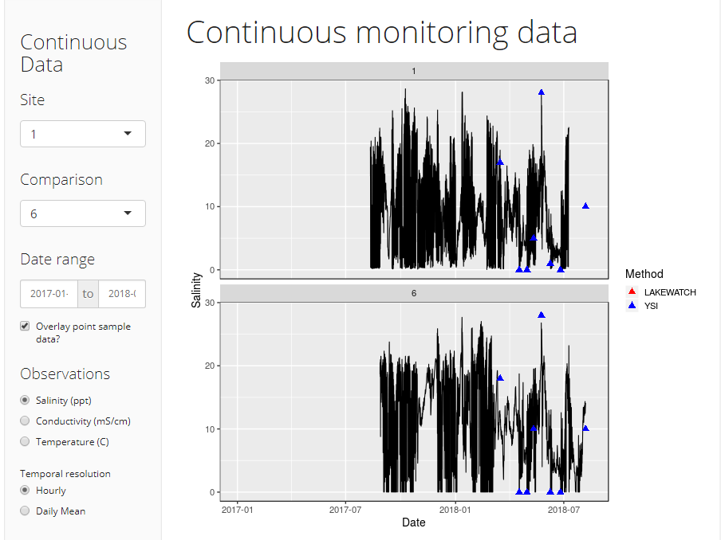
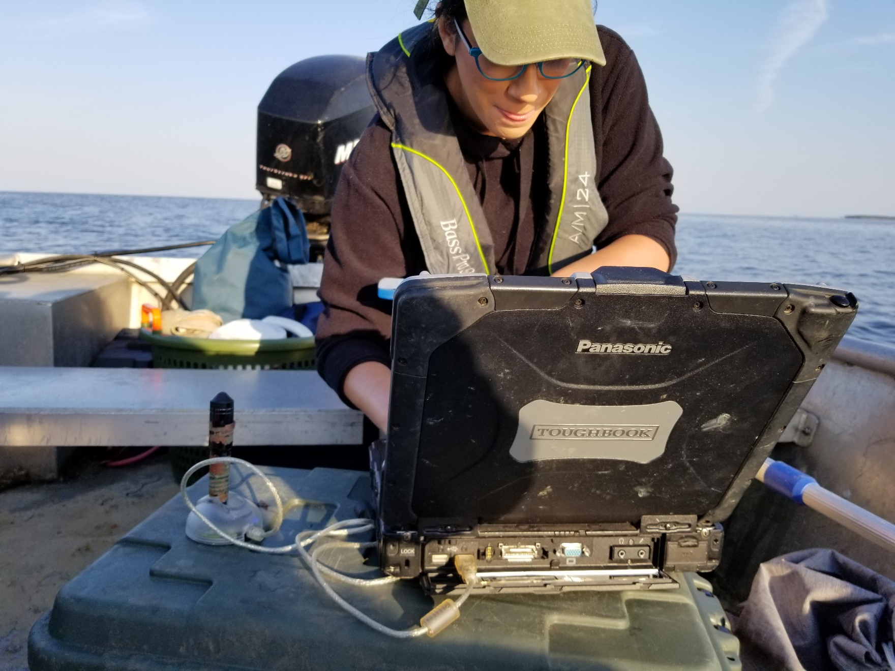



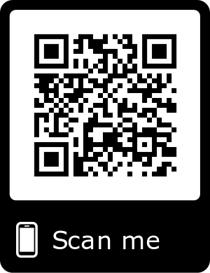
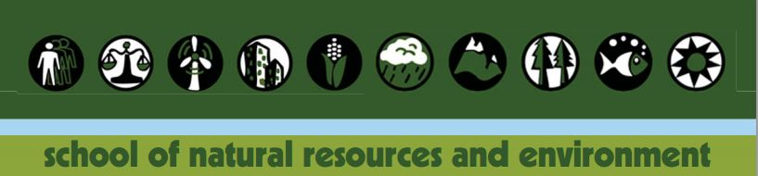

Project overview:
The Lone Cabbage Reef (LCR) restoration project is a large restoration effort in the eastern Gulf of Mexico funded by NFWF-GEBF. The project’s primary goal is to restore historic oyster reefs to promote resilience to sea level rise and fluctuations in river discharge. This project generates data from multiple sources including continuous autonomous water quality data from sensors and observations of oyster populations from field biologists. These data are generated at different time frequencies with sensor data obtained at hourly time intervals from multiple spatial locations and biological data collected at discrete time intervals from multiple spatial locations.
Introduction:
“Living data” are defined as data which are continuously collected. These data are a critical component of the adaptive management process to inform decision making as practiced by the LCR project. These decisions can be small such as shifting the location of an autonomous sensor, to larger changes including restoration practices or revamping of sampling programs because of low statistical power. Living data are challenging with from a data management perspective because the data (by design) continuously change as new data are collected.
Objectives:
Develop and implement a data management workflow, which starts at the data collection point and ends at the visualization/ interpretation of collected data from different data streams.
I will document how these data are recorded, data quality assurance/quality control procedures, data checking (anomalous values), data visualization, and data releases for analyses using multiple software tools.
Implementing a modern data workflow:
Creating and automating a data workflow for living data is an emerging skill for natural resource professionals. More than ever, data management is recognized as a core skill for biologists and ecologists (Hampton et al. 2017).
Big Changes in the Big Bend:
A Data Management Story
Changes in the Big Bend: A Data Management Story
Figure1- USGS Data Management Guidelines
Data Collection:
One goal of a data management plan is to minimize errors in data collected. Often, the first step in the data collection process is transcribing an observation in the field to paper or electronic data sheets for analyses back in the lab. This simple effort of recording the data in the field is the first opportunity to introduce errors in the data collection process. In the LCR project we try to reduce these errors by pre-defining abbreviations for site, gear, and other information before going in the field. We also pre-populate datasheets when possible.
QA/QC during data entry:
Paper data sheets to electronic records
The process of transferring data from paper datasheets to electronic form is a common source of potential errors.
Transfer electronic records from sensor to database
When individually collected sensor data files are transported back to the lab these files must be checked for errors and the data amended to an existing database to provide a continuous record of the water quality observations of interest. In our project this is done by:
Step 1. Automated data import using custom Python code for initial QA/QC and storing in mySQL database for storage.
Step 2. Create a series of checks to ensure data integrity.
Step 3. Visualization and summary tables
Figure 2- Shiny App for continuous water quality monitoring data.
Version control of data and code:
Version control is “a tool for managing changes to a set of files” (Huang and Gonzalez. Using version control reduces the likelihood of overwriting data or code and makes sharing of both easier across team members.
Decision making:
This information will be useful for (1) increasing efficiency in the LCR project. By establishing a data workflow at the beginning of the LCR restoration project we can adapt the restoration effort over the 8 years of the project to more rapidly understand how changes in freshwater discharge and substrate impact salinity and oyster populations. By continuously processing and analyzing these data, the LCR project can inform other proposed conservation efforts in Apalachicola and elsewhere in Florida. This will improve the likelihood of other restoration projects having the desired outcomes.
Authors: Melissa Moreno, Joe Aufmuth, Dr. Bill Pine
Managing and analyzing large biological datasets requires a great deal of design and planning prior to data collection. Overall these efforts improve data accuracy and accelerate learning through improved workflow from data collection through analyses.
Acknowledgments:
Dan Maxwell - Associate University Librarian at the University of Florida
Plato Smith - Data Management Librarian at the University of Florida
Robert Phillips - Information Technologist, George A Smathers Libraries at the University of Florida
Peter Fredrick - Research Professor in the Department of Wildlife Ecology and Conservation at the University of Florida
Steve Beck - Research Coordinator for Lone Cabbage Reef Restoration Project at the University of Florida
Sarah Meyer - Health Sciences Librarian at the University of Florida

